Slide 1






OBJECTIVE
To analyze Adidas’ sales performance across products, regions, channels, and customer segments, providing insights that support strategic decision-making and identify key growth opportunities.
$ 900M
-Sabaribala R

Slide 2

SALES PERFORMANCE OVERVIEW
Overall revenue reached $900M with 9,644 units distributed.
Net profit achieved: $332M with a profit margin of 4.08K.
Street Footwear led product sales ($337M), followed by Apparel ($303M) and Athletic Footwear ($260M).
Gender-wise sales: Men $486M (54.03%), Women $414M (45.97%).
Regional sales highest in the Northeast ($270M, 30%), followed by South ($186M).
Top retailers: West Gear ($243M) and Foot Locker ($220M)

Slide 3
ADIDAS MARKET INSIGHTS
Sales mix by channel: Online $357M (39.63%), In-store $296M (32.85%), Outlet $248M (27.52%).
City-level sales: Charleston and New York led with $40M each, followed by San Francisco ($35M).
State-level sales: New York ($64M) and California ($60M) ranked highest.
Retailer identifiers show largest revenue at $452M.
Gender vs Product Demand: Balanced sales across Men & Women, with steady demand for Apparel, Footwear, and Streetwear.

Slide 4
GEOSPATIAL BUSINESS INSIGHTS
State-wise distribution shows widespread coverage across the US with stronger clusters in the Northeast and West.
City-wise insights highlight dense urban sales concentration, particularly in the East Coast and central US regions.
Data enables deeper analysis of geographic hotspots for targeted business strategy

Slide 5
OVERALL SUMMARY
Adidas achieved strong performance with $900M revenue and $332M profit.
Street Footwear dominated sales, with men contributing slightly more than women.
Sales channels show online dominance, while in-store and outlet also contributed significantly.
Northeast region and key states (New York, California) lead in sales.
Insights from geospatial distribution reveal urban hubs as key drivers for future growth.

Slide 6
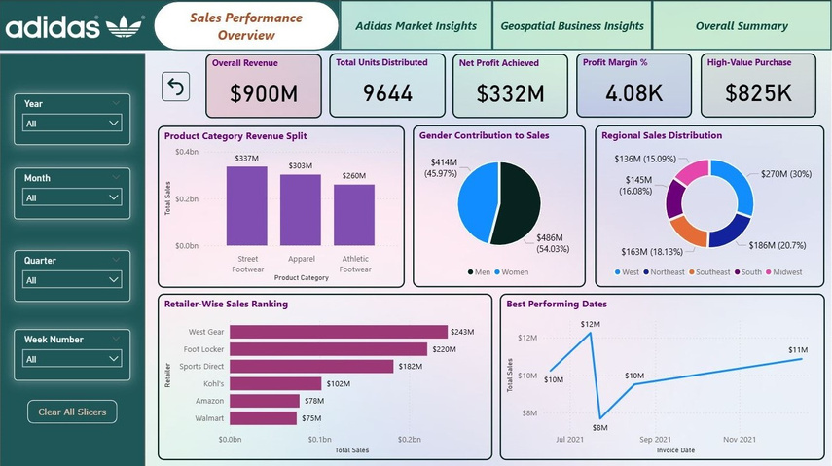
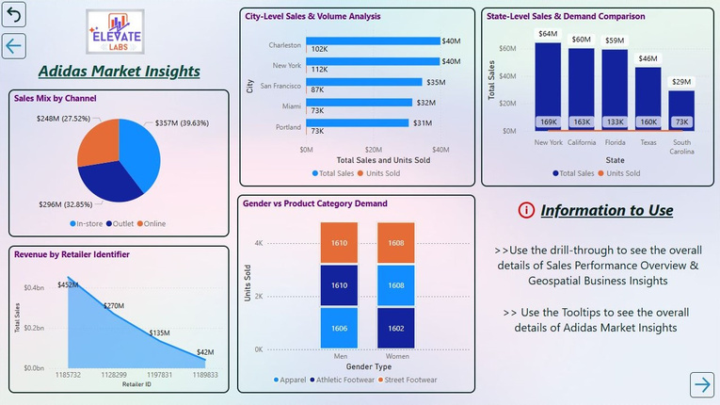
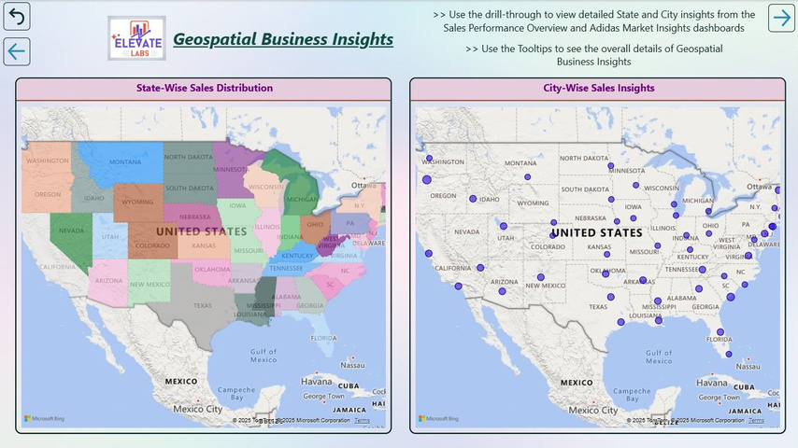
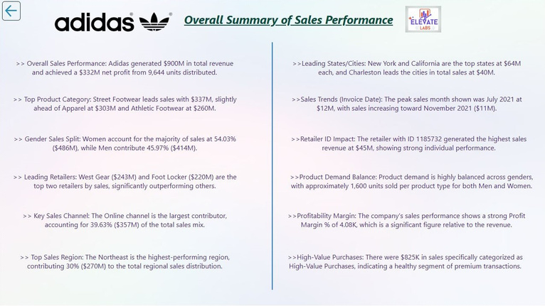
DASHBOARD VIEW

Slide 7
FINAL CONCLUSION
Adidas achieved strong sales performance with $900M in revenue and $332M in profit. Street Footwear emerged as the leading product category, while men contributed slightly higher sales than women. Online channels and major retailers drove significant revenue, with New York and California leading state-level sales. Geospatial insights highlight urban hubs as critical growth centers, positioning Adidas for continued market expansion.

